Slide 1
8th ELA Policy Handbook
Notes:
https://slidesmania.com/scrapbook-free-template-for-google-slides-and-powerpoint/
Credit to the author needs to remain on this template.

Slide 2
8th Grade ELA Policy Handbook
Google Classroom
Google Meets
Syllabus
Parents and students in
Mrs. Steele’s ELA Classes
Grades
Library Info
Misc.

Slide 3
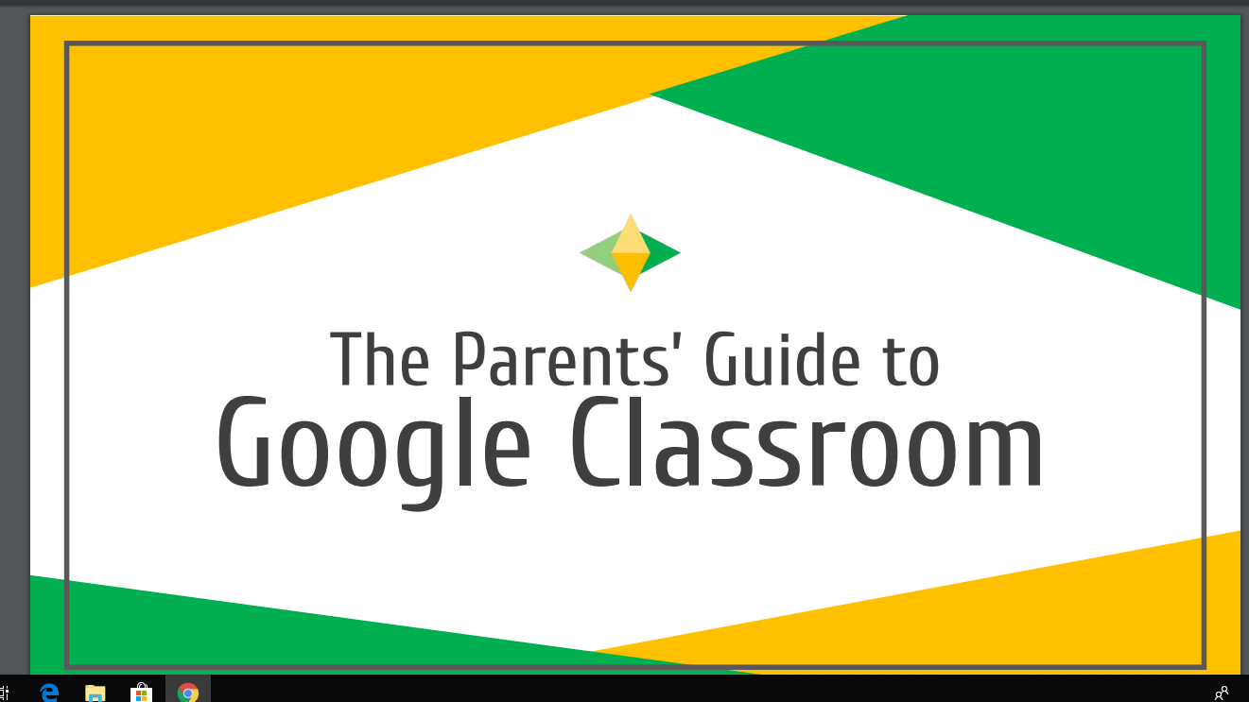
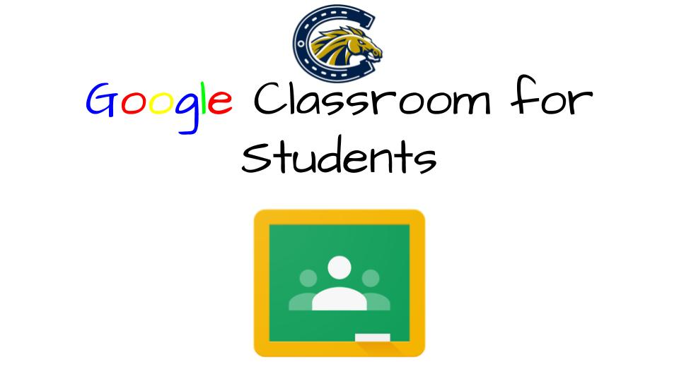
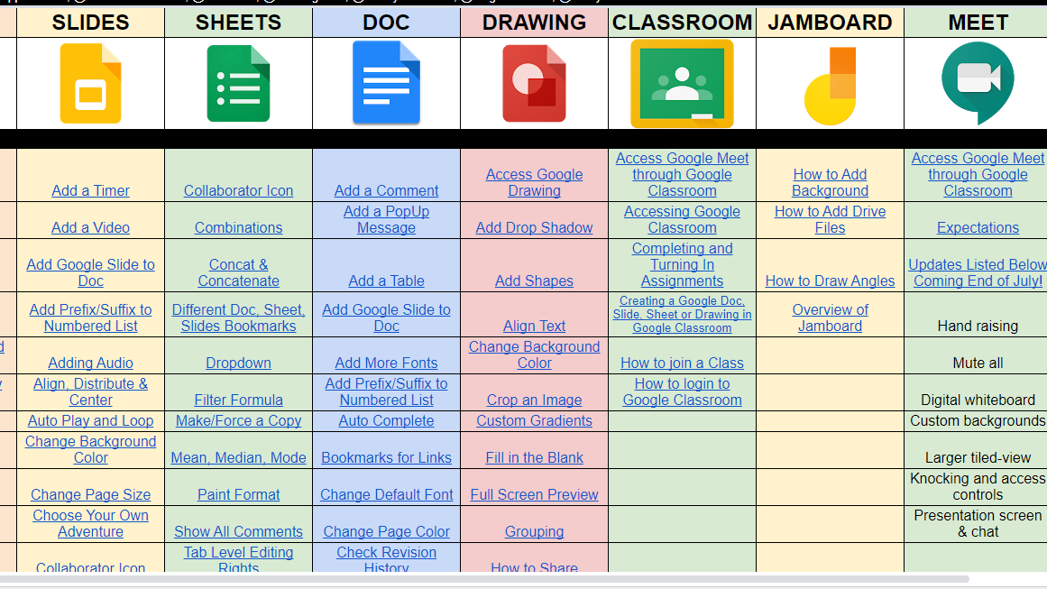
Google Classroom Students
Google Classroom Parents
Google Classroom
New to Google Classroom?
Need a refresher?
Here is a parents’ guide to Google Classroom presentation
Students: Please review this presentation to make sure you have a basic working knowledge of Google Classroom. (click on the icon below)
Google Meets
Syllabus
Need some extra resources for all things Google?
Here is a link to MANY helpful tutorials for all Google Apps.
Grades
Library Info
Misc.

Slide 4
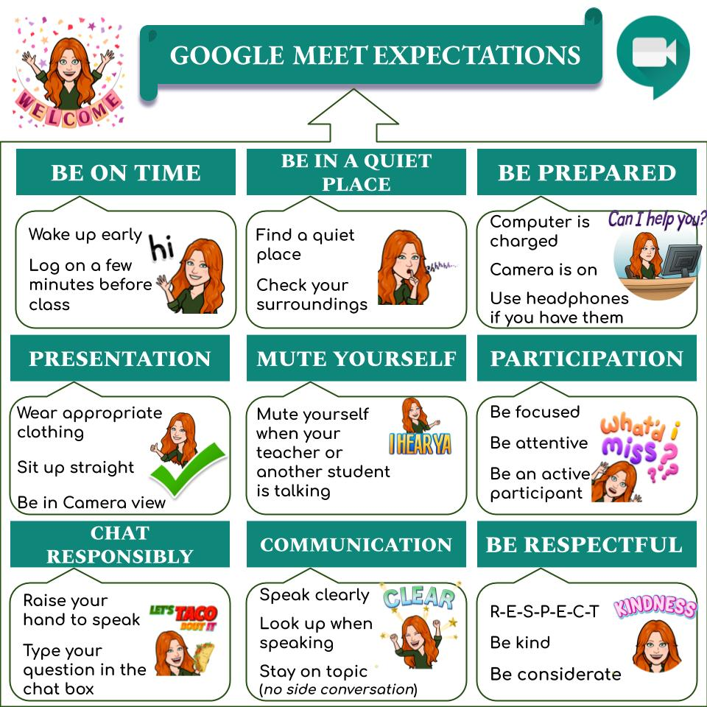
Google Meets
Google Meets
Google Classrom
Students will login and virtually attend classes during the scheduled class times. Students should anticipate the following structure for my class:
~30 minutes of “asynchronous” instruction, where the students can consume my recorded lesson at their own pace.
~30 minutes of student work time, where the students are expected to work on assignments for my class.
~30 minutes of “synchronous” instruction, where the teacher and the students are online together.
Google Meets
Class Period | Class Block Time | *Synchronous Instruction Time*( times may change)
1/2 | 7:35-9:32 | ~9:00 AM - 9:30 AM
3/4 | 9:37-12:22 | ~ 11:45 AM - 12:15 PM
6 | 12:27-2:25 | ~1:45 PM - 2:15 PM
Syllabus
Grades
Library Info
Misc.

Slide 5
Syllabus
Syllabus
Google Classroom
The ELA Syllabus is posted in Google Classroom, but here is another copy.
*Click on the Casteel Colt
Google Meets
Syllabus
Grades
Library Info
Misc.

Slide 6
Grades
Grades
Google Classroom
Grading Categories
All official grades will be posted in Infinite Campus! Google Classroom is not considered the “official” gradebook.
Semester grades will be a combination of quarter grades plus the semester final.
Ex. Semester One grade will be 40% of quarter one grade, 40% of quarter two grade, and 20% semester final.
Semester Two grade will follow the same format with quarter three and quarter four grades combined with the semester two final.
40% “Formative” Assignments | 60% “Summative” Assignments
Examples: -homework -smaller writing tasks, such as vocabulary sentences -daily short response, discussion board posts, and similar, frequent assignments | Examples: -tests, such as a test on a studied novel -larger writing projects, such as a formal essay -formal presentations, such as a book review -formal discussions, such as a socratic seminar
Google Meets
Syllabus
Grades
Average Assignments
Per CUSD policy, there will be at minimum two grades per week. Due to certain due dates, assignments may fluctuate so there may be more than two for the week.
Library Info
Misc.

Slide 7
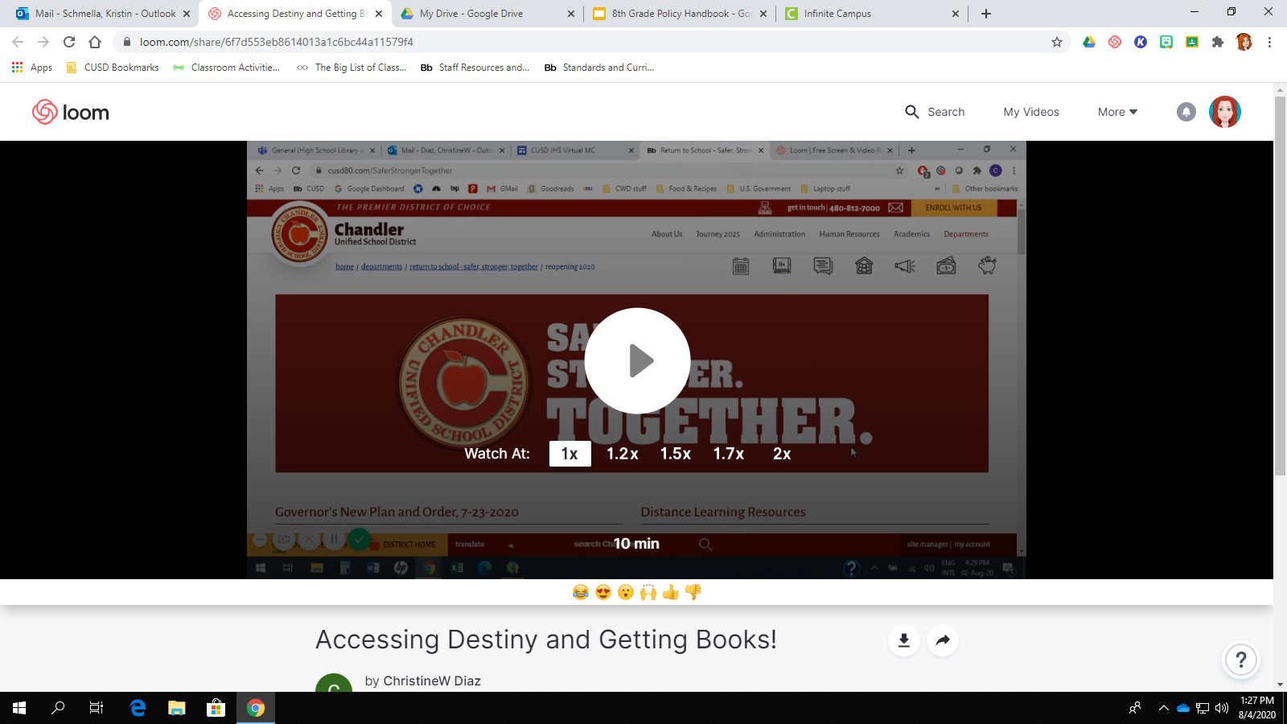
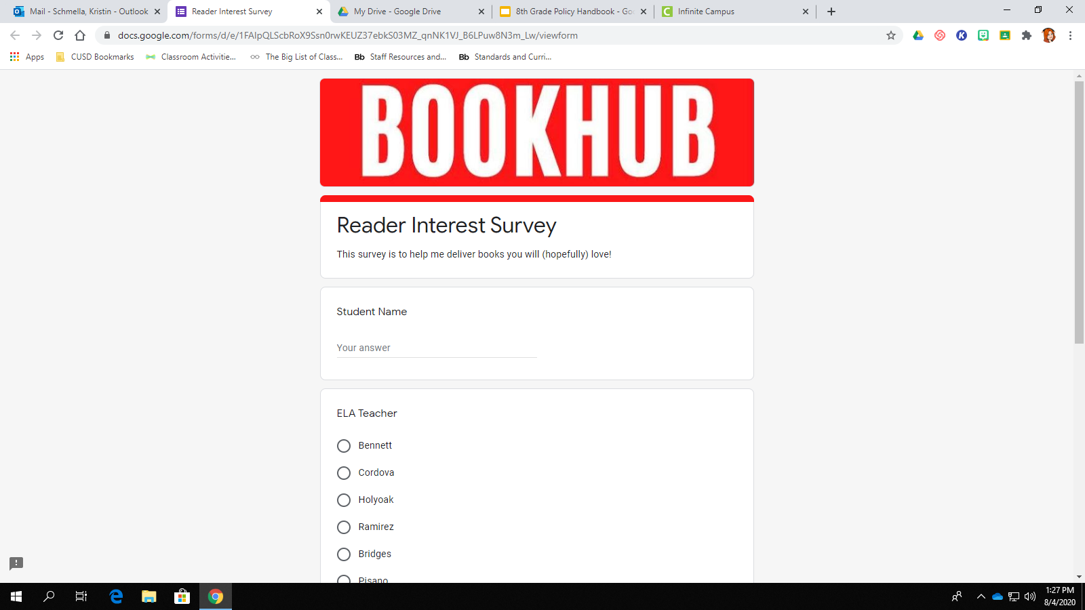
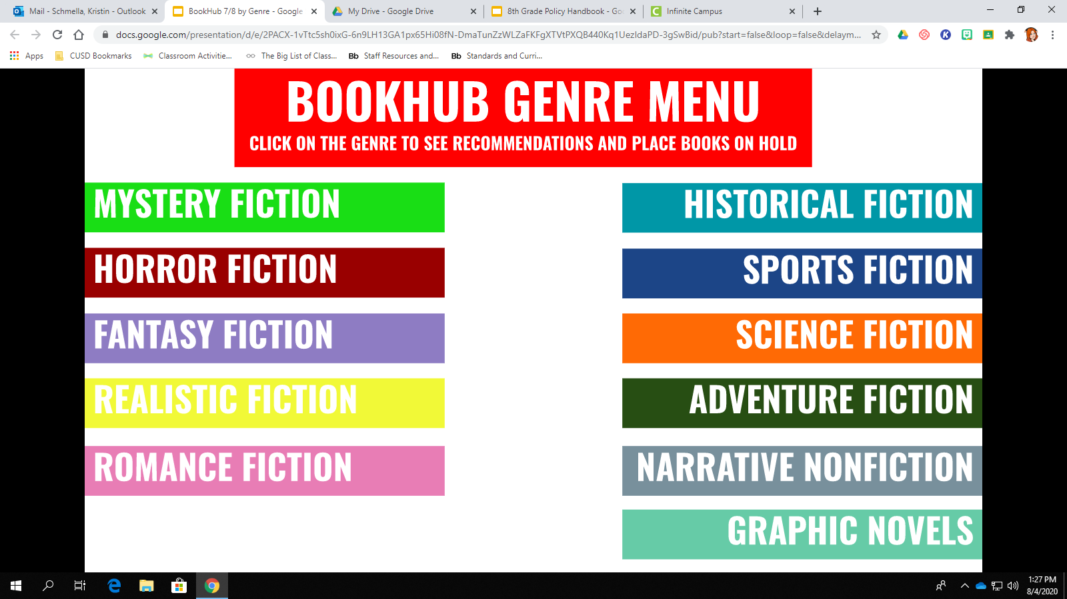
Library Info
Library Info
Google Classroom
Our media center is the absolute BEST!! Ms. Diaz and Ms. Greene work tirelessly to create a wonderful library. Please take a look at the links on the opposite page to learn how to access our library online through a program called Destiny.
There is also a link for students to take a reading survey to express what genres of books they like.
Ms. Diaz put together a book “recommendation” shelf as well- she grouped a sampling of genre specific books for easy student access!!
Students can do curbside pick up of library held books until we return in person!
Click on the icons!
Google Meets
Syllabus
Grades
Library Info
Misc.

Slide 8
Miscellaneous
Miscellaneous
Google Classroom
Once we get the year going, I will use this page to post links to common websites students will use.
For now, this is under construction
Google Meets
Syllabus
Grades
Library Info
Misc.

